Slide 1
Data Protection Seminar
Introduction
Background
GDPR
Impact on us
Practical Example
Supports Available
Questions

Slide 2
Agenda
Introduction
Background
GDPR
Impact on us
Practical Example
Supports Available
Questions
Brief introduction to Data Protection
Overview of upcoming Legislation changes
Impacts of these changes on the GAA & LGFA
Supports Available
Questions

Slide 3
Today’s Objective
Introduction
Background
GDPR
Impact on us
Practical Example
Supports Available
Questions
At the end of today’s session it is hoped that:
You will have a good understanding of the Data Protection legislation
You will have a good knowledge of the General Data Protection Regulation (GDPR)
You will understand how your own clubs will be impacted by the legislation
You will know what tools and supports are in place to help you and what is also planned in the short term
You will be sufficiently informed to understand that Data Protection is not anything to fear

Slide 4
What is Data Protection?
Introduction
Background
GDPR
Impact on us
Practical Example
Supports Available
Questions
Data Protection refers to legislation that is intended to:
  protect the right to privacy of individuals (all of us)
  ensure that Personal Data is used appropriately by organisations that may have it (Data Controllers).
Personal data is any information that can be used to identify a natural person – “Data Subject”
  Name
  Date of Birth
  Address
  Phone Number
  Email address
  Membership Number
  IP Address
  Photographs etc
Some categories of information are defined as Special Categories of Personal Data and require more stringent measures of protection. These categories include:
Religion
Ethnicity
Sexual orientation
Trade union membership
Medical information etc.
Although not listed as “special categories of personal data”, the following are also awarded additional protection:
Criminal Data
Children’s Data

Slide 5
Seven Principles of Data Protection
Introduction
Background
GDPR
Impact on us
Practical Example
Supports Available
Questions
The key objectives of Data Protection can be summarised as follows:
Lawfulness, Fairness, Transparency
Purpose Limitation (Use only for one or more specified purposes)
Data Minimisation (Collect only the amount of data required for the specified purpose(s))
Accuracy (Ensure data is kept up to date, accurate and complete)
Storage Limitation (Kept for no longer than necessary for the specified purpose(s))
Integrity and Confidentiality (Processed ensuring appropriate security of data)
Accountability (Essential not only to be compliant, but to be able to demonstrate compliance)

Slide 6
What is GDPR
Introduction
Background
GDPR
Impact on us
Practical Example
Supports Available
Questions
The General Data Protection Regulations (GDPR) is new EU legislation that comes into effect on May 25th 2018.
It very clearly sets out the ways in which the privacy rights of every EU citizen must be protected and the ways in which a person’s ‘Personal Data’ can and can’t be used.
It places the onus on any person or entity involved in the processing of a person’s information (Data Controller/Data Processor) to comply with the legislation and to demonstrate compliance
It carries significant penalties for non-compliance

Slide 7
Data Controller or Data Processor?
Introduction
Background
GDPR
Impact on us
Practical Example
Supports Available
Questions
The GDPR states that a data controller “determines the purposes and means of the processing” whereas a data processor acts only and always “on behalf of the data controller”.
The Club and the GAA centrally are joint controllers of member’s personal data.
Third parties such as Servasport, other membership system providers, messaging apps, insurance companies, online booking systems processing data on behalf of Clubs or the GAA are data processors.

Slide 8
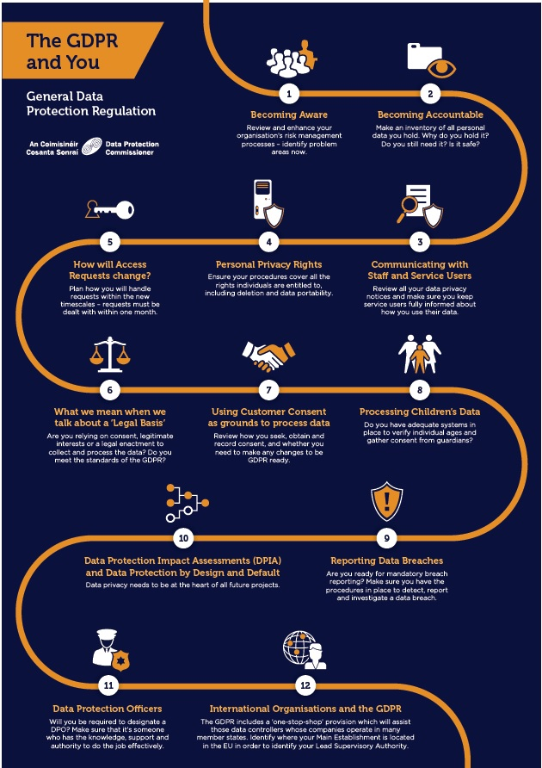
Introduction
Background
GDPR
Impact on us
Practical Example
Supports Available
Questions
How to comply
The Data Protection Commissioner has issued a guide to compliance, consisting of 12 steps.
Becoming Aware
Becoming Accountable
Communication with members
Personal Privacy Rights
Subject Access Requests
Legal Basis
Consent
Children’s Data
Reporting Breaches
Impact Assessments
Data Protection Officers
International Organisations

Slide 9
Step 1 - Awareness
Introduction
Background
GDPR
Impact on us
Practical Example
Supports Available
Questions
GDPR will benefit all of us, it will ensure that our Personal Information is protected
It will also ensure that, as a Data Controller, each GAA Club, County or Provincial Board will be accountable for how it collects, uses and stores Personal Information
Every Member should be aware of the changes that GDPR will bring and how that impacts them, either as a volunteer working on behalf of the club or as an individual Club Member.
This awareness will also benefit all of us in our personal lives.
Clubs should ensure that information relating to GDPR is made available to Committee Members, Club Members, Coaches, Volunteers or anyone who is in anyway involved with the Club.
Information regarding Data Protection can be found on the GAA website http://www.gaa.ie/dataprotection

Slide 10
Step 2 - Become Accountable
Introduction
Background
GDPR
Impact on us
Practical Example
Supports Available
Questions
It is imperative that each GAA Club understands exactly what Personal Information it holds and how it uses it
To ensure that this is clear, it is important that every club makes an inventory of the personal data that it holds and the processing activities undertaken
This Inventory or ‘Processing activities log’ should examine data under the following headings:
  Why is it being held?
  How was it obtained?
  Why was it originally gathered
  How long is it being retained for?
  How secure is it?
  Is it shared with any third parties?
  Where is it stored?

Slide 11
Step 2 - Become Accountable
Introduction
Background
GDPR
Impact on us
Practical Example
Supports Available
Questions
All registered members’ information is stored on the GAA’s central Games Management System (Servasport) and responsibility for this information is jointly held by the GAA centrally.
Other systems may be in use in Clubs and most of the third party providers of these kinds of systems (online registration, text messaging, fundraising) will be well aware of GDPR and will be able to advise on how they are ensuring compliance.
Providers of third party systems should be contacted to verify that they are in compliance with GDPR. Ensure all third party relationships are governed by a contract/other legally binding instrument to include penalties for non-compliance.

Slide 12
Step 2 - Become Accountable
Introduction
Background
GDPR
Impact on us
Practical Example
Supports Available
Questions
Other likely categories of Personal Information held by GAA Clubs will include
  Information required for Garda Vetting
  (Note: The Data Protection Commissioner has advised a timeline of one year maximum for storage of all Garda Vetting information, including identity documentation. After one year, it should be securely deleted.)
  Cúl Camp or other training camp applications
  Text or messaging systems
  Email lists or distribution groups
  Teamsheets, training attendance lists
  Information captured on club websites
There may also be others, depending on individual clubs, and it is important that each club has a record of all of the Personal Data that it ‘controls’.

Slide 13
Step 3 - Clear Communication
Introduction
Background
GDPR
Impact on us
Practical Example
Supports Available
Questions
It is required that individuals are aware of certain information before their data is obtained.
Existing membership forms, and other forms used to collect data (e.g. Garda Vetting, Websites, etc.) must be updated to specifically tell individuals the following:
  The Club’s identity
  The reasons for collecting the information
  The uses it will be put to
  Who it will be shared with
  If its going to be transferred outside the EU
  The legal basis for processing the information
  How long it will be retained for
  The right of members to complain
  Whether it will be used for automated decision making
  Other specific personal privacy rights relevant under GDPR

Slide 14
Step 4 – Personal Privacy Rights
Introduction
Background
GDPR
Impact on us
Practical Example
Supports Available
Questions
GDPR enshrines certain rights for individuals that must be supported by every Data Controller, including GAA Clubs.
These rights include:
  Subject Access
  To have inaccuracies corrected
  To have information erased
  To object to direct marketing
  To restrict processing of their information including automated decision making
  Data portability - Ability to receive all of their information in a standard format to move to another provider (more relevant for switching banks or utility providers than GAA Clubs but must be supported)

Slide 15
Step 5 - Subject Access Requests
Introduction
Background
GDPR
Impact on us
Practical Example
Supports Available
Questions
Under Data Protection, a person has always had the right to request access to all of the information held about them
This is called a Subject Access Request (SAR)
Subject Access Requests must be completed within one month free of charge
Holding an accurate inventory of information will be a key enabler for completing SAR efficiently
Data has to be provided in a standard format
The person must also be informed of further information, including the relevant Retention Periods for the data held and their right to have inaccuracies corrected

Slide 16
Step 6 - Legal Basis for Data Processing
Introduction
Background
GDPR
Impact on us
Practical Example
Supports Available
Questions
Processing of Personal Information can only occur when there is a legal basis for carrying it out.
Legal Basis can be established where one of the following applies:
  The person has given explicit consent
  Necessary for performance of a contract
  Compliance with a Legal Obligation
  To protect the vital interests of the person
  A task carried out in the public interest
  For the legitimate interests of the data controller
The legal basis for processing should be recorded

Slide 17
Step 7 - Obtain & Manage Consent
Introduction
Background
GDPR
Impact on us
Practical Example
Supports Available
Questions
Individuals must be informed of what their data is going to be used for, who will have access to it, where it will be stored and how long it will be held for.
They must give their consent for their data to be used.
Consent must be ‘freely given, specific, informed and unambiguous’.
Members cannot be forced into consent or unaware that they are giving consent.
Obtaining consent requires a positive indication of agreement – it cannot be inferred through silence (not objecting), pre-ticked boxes or inactivity.

Slide 18
Step 7 - Obtain & Manage Consent
Introduction
Background
GDPR
Impact on us
Practical Example
Supports Available
Questions
Consent must be ‘refreshed’ – It cannot be deemed as indefinite
Consent must also be verifiable – Data Controllers must be able to demonstrate that consent was given and an audit trail should be maintained
‘Legal Basis’ can be used to process information in the absence of consent in certain, very specific, circumstances
It must be easily possible for a person to withdraw their consent

Slide 19
Step 8 - Children’s Data
Introduction
Background
GDPR
Impact on us
Practical Example
Supports Available
Questions
Under GDPR, children are not permitted to give consent for Data Processing
A child’s Parent or Guardian must give consent on their behalf
Procedures must be in place to verify individual’s ages (for juveniles)
Existing GAA policy relating to Juvenile members already supports this legislative requirement

Slide 20
Step 9 - Report Data Breaches
Introduction
Background
GDPR
Impact on us
Practical Example
Supports Available
Questions
If unauthorised access to Personal Data occurs or Personal Data is lost or stolen, this must be notified to the Data Protection Commissioner within 72 hours of being identified.
This is a requirement for all paper information and all electronic information (unless the data is encrypted or anonymised).
If the breach is likely to cause harm to the individual (Identity Theft or breach of confidentiality) then the individual must also be informed.
A procedure to detect, report and investigate data breaches should be in place.
It is imperative that Data Breaches or possible Data Breaches are not ignored in the hope that no one will notice, they must be investigated and reported if appropriate to do so.
Advice on data protection queries can be obtained on the gaa website http://www.gaa.ie/dataprotection or by emailing dataprotection@gaa.ie.

Slide 21
Introduction
Background
GDPR
Impact on us
Practical Example
Supports Available
Questions
Step 10 – Data Protection Impact Assessments
GDPR seeks to ensure that all significant new processes, initiatives or projects undertaken consider and ensure GDPR compliance
The concept of ‘Privacy by Design and by Default’ is a key theme within GDPR
This requires that a Data Protection Impact Assessment must be undertaken to understand the potential impact of that project / initiative on the privacy of individuals prior to the processing taking place
GAA Clubs that are considering projects with ‘high risk’ processing (i.e. new technology) or installing CCTV should conduct a Data Privacy Impact Assessment
A Data Privacy Impact Assessment can be conducted by meeting relevant stakeholders, identifying potential privacy issues and agreeing ways to mitigate the risk of issues occurring
Data Protection Impact Assessments must be documented and retained

Slide 22
Step 11 - Data Protection Officers
Introduction
Background
GDPR
Impact on us
Practical Example
Supports Available
Questions
Every GAA Club should identify someone to coordinate their approach to meeting their Data Protection obligations
This will involve identifying and recording the specific locations where data is held in each club, ensuring that access to the data is controlled, ensuring that consent is obtained in the appropriate manner and maintained accordingly
The GAA centrally will have expertise available for any Data Protection queries that require additional / legal advice. Queries of this nature can be submitted to dataprotection@gaa.ie

Slide 23
12 - International Organisations
Introduction
Background
GDPR
Impact on us
Practical Example
Supports Available
Questions
GDPR includes a ‘one-stop shop’ provision for Organisations that operate in more than one jurisdiction
A Lead Supervisory Authority can be nominated
For the GAA this will be the Data Protection Commissioner, based in Portlaoise

Slide 24
GDPR Timelines
Introduction
Background
GDPR
Impact on us
Practical Example
Supports Available
Questions
GDPR is coming into effect on May 25th 2018
All data processing from that date will legally be required to comply with GDPR.
There are consultations and working groups on-going within the EU and Member States to produce guidance on certain elements of the regulations.
Recital 171 of GDPR makes allowance to bring ‘non-GDPR’ processing already underway into compliance within 2 years.
If consent was already obtained in a manner consistent with GDPR, it is not necessary to obtain consent again (immediately after May 25th).

Slide 25
Impacts on the GAA
Introduction
Background
GDPR
Impact on us
Practical Example
Supports Available
Questions
GDPR places responsibilities on GAA units to comply and to demonstrate compliance
  Consent needs to be obtained and refreshed regularly
  Privacy statements need to be updated
  Information needs to be protected and accurate
  Specific locations of information must be known
  Subject Access Requests must be facilitated (1 month)
  Breaches must be reported within 72 hours
  Privacy by design and by default must be adopted
New procedures must be implemented to enable the above throughout the lifecycle of the data

Slide 26
Information Life Cycle
Introduction
Background
GDPR
Impact on us
Practical Example
Supports Available
Questions
The diagram below illustrates four main stages in the life cycle of information
Capture
Store
Use
Destroy
Capture – Obtain and record information
Store – Save the information electronically or in paper format
Use – Use or reuse information
Destroy – Delete, erase or shred information

Slide 27
GDPR Information Life Cycle
Introduction
Background
GDPR
Impact on us
Practical Example
Supports Available
Questions
Under GDPR, the information life cycle will remain broadly the same, however there are additional factors to be considered at each stage
Capture
What you are allowed to capture
How you may do so
What you must tell the person in advance
What you must get from them (their permission)
Store
How you must store it
Where it can be stored
Obligations of third parties
What happens if you lose it
Use
What you can use it for
What you can’t use it for
Destroy
How long you can keep it for
When you must destroy information
Capture
Store
Use
Destroy

Slide 28
GDPR Information Life Cycle
Introduction
Background
GDPR
Impact on us
Practical Example
Supports Available
Questions
Capturing Information under GDPR
Capture
Store
Use
Destroy
Data Minimisation (Only ask for what is needed)
Privacy Notices (Clearly inform what, why, who and where)
Data Subject Rights (state the persons rights under the legislation)
Obtain Consent (consent must be freely given and explicit for the purpose or purposes)

Slide 29
GDPR Information Life Cycle
Introduction
Background
GDPR
Impact on us
Practical Example
Supports Available
Questions
Storing Information under GDPR
Safe and Secure (Information must be stored appropriately e.g. locked cabinets/password protected files)
Restricted Access (Only authorised persons should have access to it)
Data Inventory (Information captured should be recorded)
Subject Access Requests (Must be in a position to provide ALL information held)
Contracts with Data Processors (Any third parties must have GDPR contracts in place)
Data Breaches (Processes to detect, report and investigate Data Breaches must be in place)
Capture
Store
Use
Destroy

Slide 30
GDPR Information Life Cycle
Introduction
Background
GDPR
Impact on us
Practical Example
Supports Available
Questions
Use of Information under GDPR
Appropriate use (Must be for the purpose(s) originally stated)
Consent (Must have person’s consent or a lawful basis for processing it)
Manage Consent (Individuals have the right to revoke consent for part or all of the processing, this must be managed)
Restricted (Profiling or automated decision making are restricted)
International Transfers (Any processing that occurs outside EU must have been communicated to person at time of data capture and must have additional safeguards in place)
Capture
Store
Use
Destroy

Slide 31
GDPR Information Life Cycle
Introduction
Background
GDPR
Impact on us
Practical Example
Supports Available
Questions
Destruction of Information under GDPR
Retention Period (Retention periods must be documented and justified and data must be destroyed after its useful retention period has expired).
Right to erasure (Must be erased upon request from person)
Portability (Must be provided in standard format)
Third Party Copies (All copies of information must be deleted including those held by third parties. Systems like Whatsapp can be an issue here due to the lack of control over the personal data held within it.)
Capture
Store
Use
Destroy

Slide 32
GDPR Information Life Cycle
Introduction
Background
GDPR
Impact on us
Practical Example
Supports Available
Questions
There is a fifth step required under GDPR, that is the needed to ensure Privacy by Design through upfront assessment of relevant projects
Assess
Store
Use
Destroy
Capture
Data Protection by Design and by Default (All relevant projects or initiatives must consider impacts on privacy from the outset)
Data Protection Impact Assessment (DPIA) (Must be conducted for new technology, profiling, large scale processing, or engagement of a new third party data processor)
Documentation (Decisions and rationale for decisions around Data Protection should be documented)

Slide 33
Introduction
Background
GDPR
Impact on us
Practical Example
Supports Available
Questions
Summary of GDPR Information Life Cycle
Data Protection by Design and by Default
Data Protection Impact Assessment (DPIA)
Documentation
Assess
Store
Use
Destroy
Capture
Retention Period
Right to erasure
Portability
Third Party copies
Data Minimisation
Privacy Notices
Privacy Rights
Obtain Consent
Appropriate use
Consent
Manage Consent
Restricted
International Transfers
Safe and Secure
Restricted Access
Data Inventory
Subject Access Requests
Contracts with Data Processors
Data breaches

Slide 34
Introduction
Background
GDPR
Impact on us
Practical Example
Supports Available
Questions
GDPR Practical Example
St Mary’s GAA Club has a new Sports Hall and Astro Pitch and wishes to make it available for hire
They intend to use an on-line form to allow the public to reserve the hall or astro pitch
Payments won’t be accepted on-line, cash will be collected on arrival
A committee has been setup to run the facilities and to ensure lights / showers etc are available
Committee members will require contact information for those who make bookings in case there are any last minute changes

Slide 35
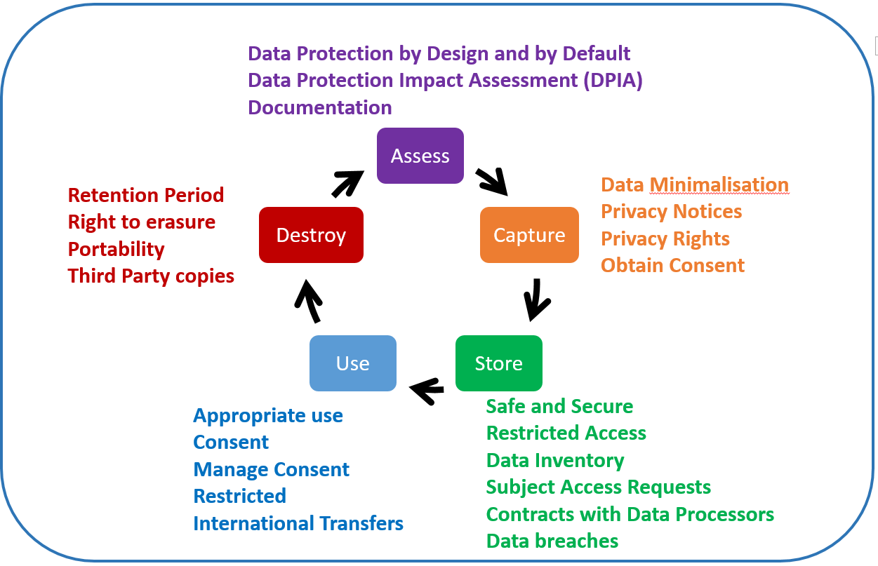
Introduction
Background
GDPR
Impact on us
Practical Example
Supports Available
Questions
GDPR Practical Example
The first step for St Mary’s is to Assess the project from a GDPR point of view
This project does involve capturing personal information therefore a Data Protection Impact Assessment should be conducted
It should include:
  a description of the envisaged processing operations and the purposes of the processing;
  an assessment of the necessity and proportionality of the processing operations in relation to the purposes;
  an assessment of the risks to the rights and freedoms of data subjects; and
  the measures envisaged to address the risks, including safeguards, security measures and mechanisms to ensure the protection of personal data and to demonstrate compliance
This process should be documented

Slide 36
Data Protection Impact Assessment Process
Introduction
Background
GDPR
Impact on us
Practical Example
Supports Available
Questions
1. Description of Envisaged Processing
2. Assessment of Necessity and Proportionality
4. Assessment of the Risks to Rights and Freedoms
5. Measures Envisaged to Address the Risks
6. Documentation
7. Monitoring & Review
3. Measures Envisaged to Demonstrate Compliance

Slide 37
Introduction
Background
GDPR
Impact on us
Practical Example
Supports Available
Questions
GDPR Practical Example
St Mary’s needs to consider the information intended to be captured and the privacy information provided
The amount of data requested should be minimal, restricted to what is needed to process a booking
The Privacy Notices must clearly inform the person of
  The club’s identify and contact details;
  The purpose for which its being collected – processing a pitch booking
  Who it will be shared with – in this case the ‘committee’ and Online Bookings Limited.
  Where the data is stored and who has access to it
  The name and contact information of the on-line provider
  How long it will be held for
Their privacy rights including withdrawing consent and right to object to processing or complain to the Data Protection Commissioner

Slide 38
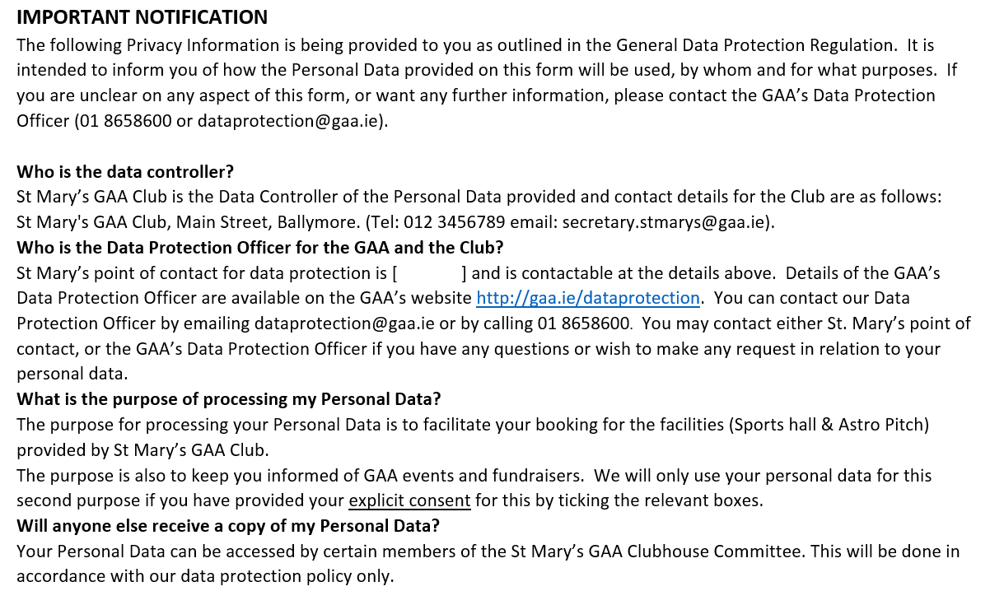
Introduction
Background
GDPR
Impact on us
Practical Example
Supports Available
Questions
Sample Privacy Notice

Slide 39
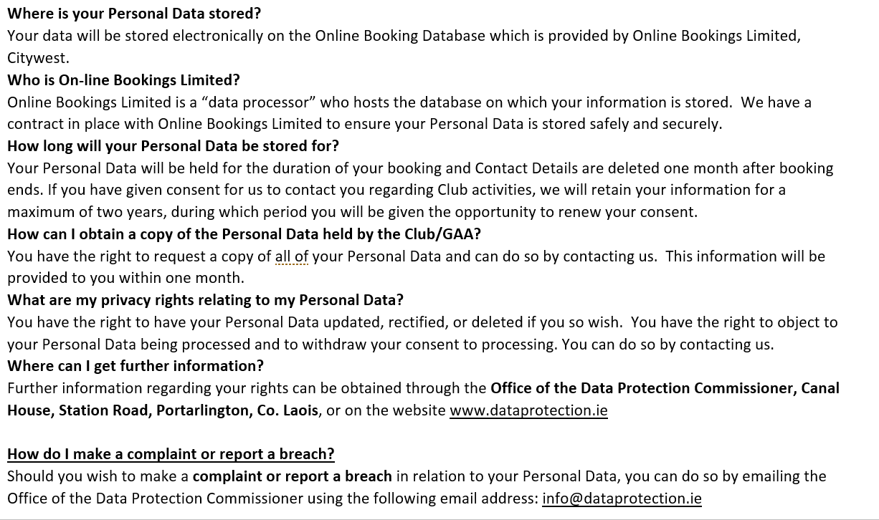
Introduction
Background
GDPR
Impact on us
Practical Example
Supports Available
Questions
Sample Privacy Notice (cont.)

Slide 40

Introduction
Background
GDPR
Impact on us
Practical Example
Supports Available
Questions
GDPR Practical Example
Careful attention needs to be paid to how consent is obtained.
The request for consent must be clearly explained and freely given
It cannot be ‘bundled’ – i.e. it cannot include ‘I consent to having my data processed for the purpose of administering my booking and I consent to marketing mails from our sponsors’
A positive indication of consent must be obtained – Tick a box (Never untick a box to withdraw consent)
It must be clear that they can withdraw consent at any time and this must be managed – i.e. if they withdraw consent, St. Mary’s must stop processing their data.

Slide 41
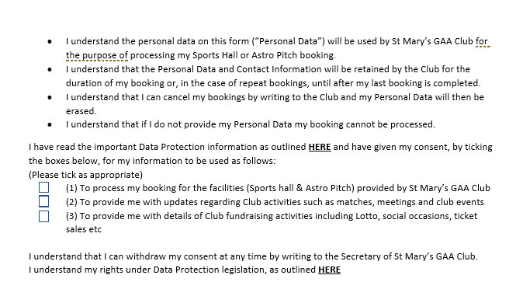
Introduction
Background
GDPR
Impact on us
Practical Example
Supports Available
Questions
Sample Online Consent

Slide 42

Introduction
Background
GDPR
Impact on us
Practical Example
Supports Available
Questions
GDPR Practical Example
Storing of personal information after it has been captured must be carefully planned and controlled.
The controls in place for restricted access must be understood & documented
The categories of data captured should be added to the Clubs’ log of processing activities (personal data inventory).
A process to manage Subject Access Requests should be in place
Contracts with the on-line provider must cater for GDPR requirements
A process to monitor and report data breaches must be in place
The retention period must be agreed, implemented, documented and justified.

Slide 43
Introduction
Background
GDPR
Impact on us
Practical Example
Supports Available
Questions
Sample Log of Data Processing Activities

Slide 44
Introduction
Background
GDPR
Impact on us
Practical Example
Supports Available
Questions

Slide 45
Introduction
Background
GDPR
Impact on us
Practical Example
Supports Available
Questions

Slide 46

Introduction
Background
GDPR
Impact on us
Practical Example
Supports Available
Questions
GDPR Practical Example
How the data is used must also comply with the Regulations
It can only be used for the purposes for which it was originally captured – in this case managing the hall or pitch booking
The information must be kept up to date – in this example it is unlikely that any meaningful change to data will occur during its lifecycle
Consent must be maintained and updated
It is unlikely that, in this example there will be automated processing or decision making or international transfers

Slide 47

Introduction
Background
GDPR
Impact on us
Practical Example
Supports Available
Questions
GDPR Practical Example
Data must be destroyed once it has passed its retention period or upon request from the individual.
Remember, all copies (hard and soft copy) must be destroyed including any ‘backup’ copies held by the provider or third parties.
For Pitch Bookings, it is unlikely that the data is needed after the booking has been completed and retention periods should reflect this.
It is possible to maintain summary information for ‘statistical purposes’ but this shouldn’t include name or contact information. Initials and the purpose for the booking should suffice.
If there are repeat bookings, it would be permissible to retain the information for longer periods – this would need to have been communicated to the individual when giving their consent.
It is unlikely that, in this example, data portability would be a factor.

Slide 48
Introduction
Background
GDPR
Impact on us
Practical Example
Supports Available
Questions
Checklist of things to do
Ensure Awareness within club
Ensure Privacy by Design & Default
Create Inventory of Data Processing Activities
Review Access to Personal Information
  Evaluate who has access to personal data on the GMS (Servasport) and ensure they are authorised.
  Implement leavers process for all outgoing users.
  Evaluate any other systems that hold member information for appropriate access
  Never share passwords or logon details
Ensure any third parties have provided assurance on GDPR compliance and appropriate legal agreements are in place.
Ensure Paper Forms are stored in known and safe locations and are securely locked.
Ensure any Laptops holding data are encrypted
Ensure any spreadsheets and other documents are password protected
Ensure Subject Access Request and Data Breach processes are in place
Ensure documentation is in place
Ensure BCC Function on email is used
Leverage OneDrive as a mechanism to keep electronic data secure

Slide 49
Introduction
Background
GDPR
Impact on us
Practical Example
Supports Available
Questions
Supports Available
The GAA Centrally will provide
Access to Data Protection Officer
GDPR compliant processes (SAR, Data Breaches)
GDPR compliant templates (Privacy Notices, Obtaining Consent, Data Privacy Impact Assessment)
Tools to support compliance
  GAA Membership App
  OneDrive and Office365
Training & Awareness for all levels of the GAA
  Seminars in Croke Park
  On-line training module (http://learning.gaa.ie/courses/dataprotection)
  Reference Documentation on the GAA Website (http://www.gaa.ie/dataprotection)
  Updates in Club Newsletter

Slide 50
GAA Management System (Servasport)
Introduction
Background
GDPR
Impact on us
Practical Example
Supports Available
Questions
Updates to GAA Management System to support GDPR
Mobile Application to support
  Registration (Personal Information – Secure, accurate up to date)
  Payments
  Communications (Consent)
  Reduction in paper records

Slide 51
Office365
Introduction
Background
GDPR
Impact on us
Practical Example
Supports Available
Questions
Use of Office 365 Accounts (@gaa.ie email addresses) will support GDPR
OneDrive can be used to securely store information
Access to OneDrive can be controlled
Microsoft Office Products (Word / Excel) can be password protected to ensure security
Further information available on-line

Slide 52

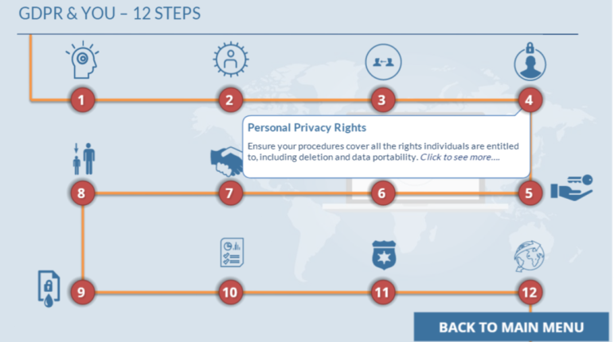
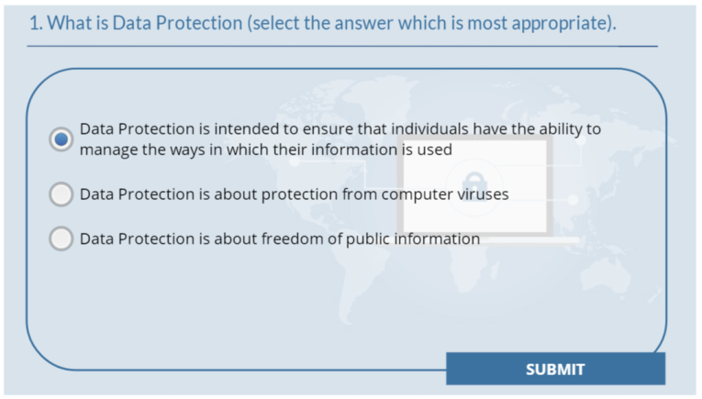
Online Materials
Introduction
Background
GDPR
Impact on us
Practical Example
Supports Available
Questions
Relevant information is available on website http://GAA.ie/dataprotection
On-line course available http://learning.gaa.ie/courses/dataprotection
Multiple choice quiz included to test your knowledge

Slide 53
Questions
Introduction
Background
GDPR
Impact on us
Practical Example
Supports Available
Questions
                Thank you!

